Slide 1
Natural Selection and Invasive Species
Curriculum PowerPoint
authors: Jonathan anderson-Norfolk, NE high school Teacher
allison zach-Nebraska invasive species program coordinator

Slide 2


What’s in your Chair?
As you enter class, you might be surprised to see what is on your chair
Do No Sit Down! You can must choose a card from the from the board and place it next to the stick/picture on your chair

Slide 3
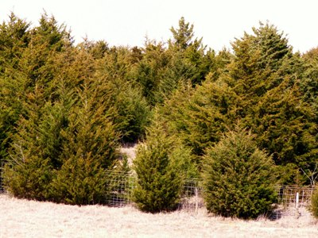
Why are E. Redcedar trees a threat?
  Native to central plains with adaptations:
    Grows in many soil types
    Drought tolerant
    Birds spread seeds
      Digestion actually improves germination
  They are invading non-native areas
    Lack of fire to control their spread
    Grazing and mechanical removal of trees is employed too late instead of being proactive they are reactively controlled

Slide 4
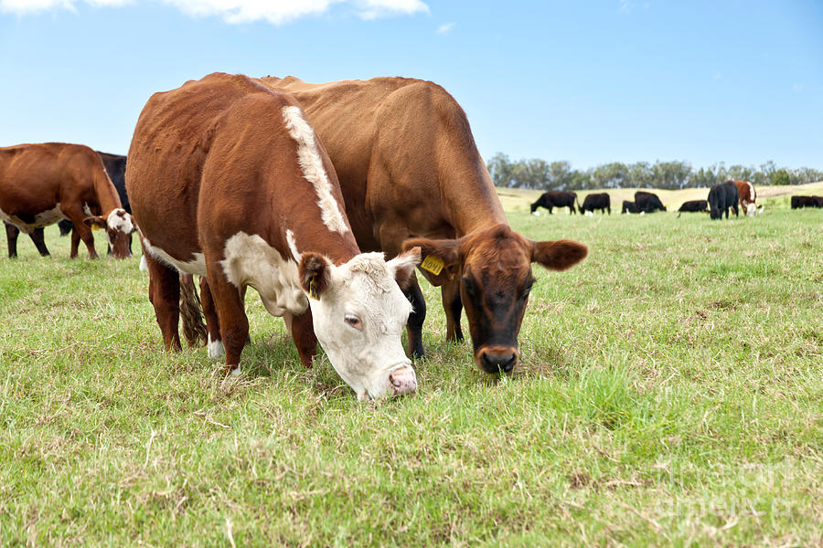
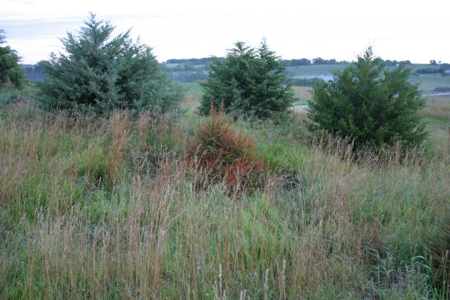
E. Redcedar Infestations
Cattle require pastures dominated by non-woody vegetation
E. redcedar infestations reduce the amount of food available for cattle to graze
E. redcedar infestations can reduce the amount of acres available to graze cattle affecting cattle production
Pasture providing grazing food for cattle
E. Redcedar infestation reducing cattle forage resources

Slide 5
Control & Management Techniques
The stage of infestation dictates the best control strategy
Integrated approaches (combining several management controls) are successful by reducing and controlling invasions

Slide 6
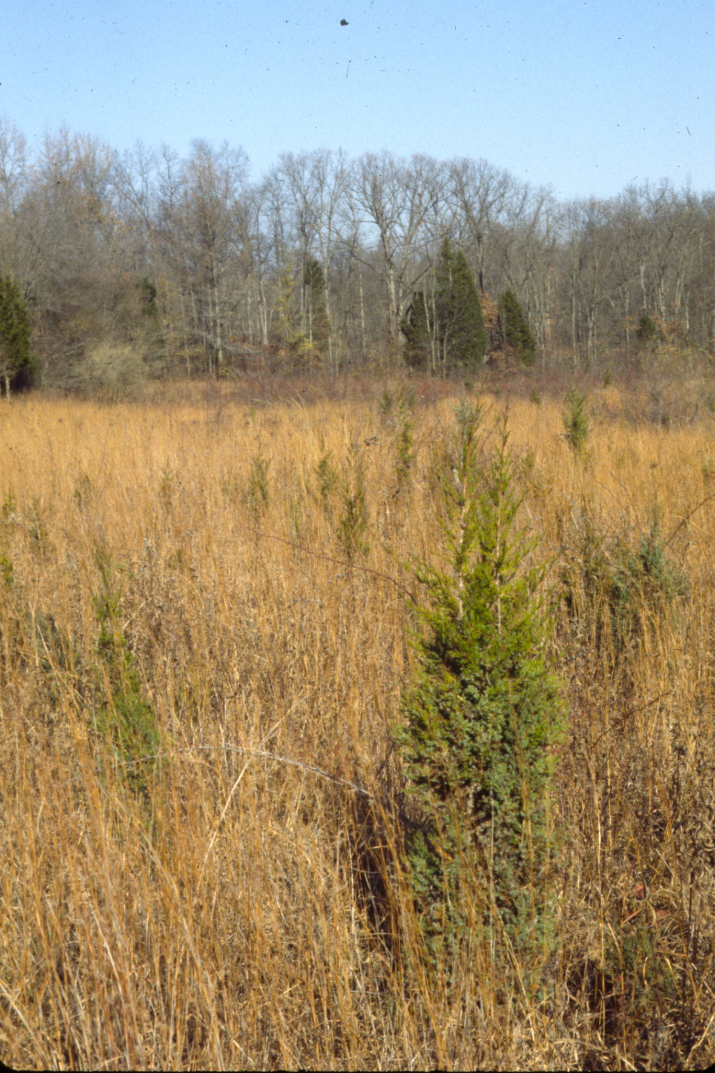
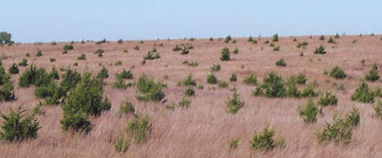
Early Invasions
Important to control invasions as early
Options:
  Controlled burn
  Intensive Goat Grazing
  Spraying

Slide 7
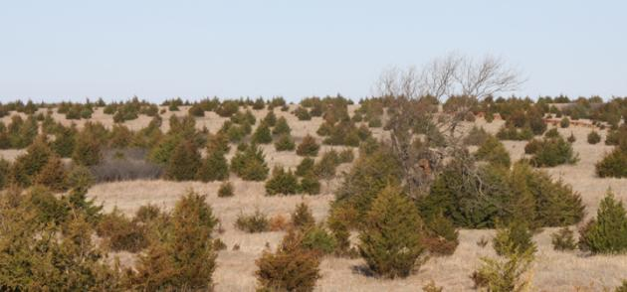
Adult Tree Infestations
Costly & difficult to control
Controlled burning coupled with Mechanical removal are options
Proactive vs. Reactive control is best
Control small infestations to keep them manageable and preserve existing farming land and wildlife habitat

Slide 8
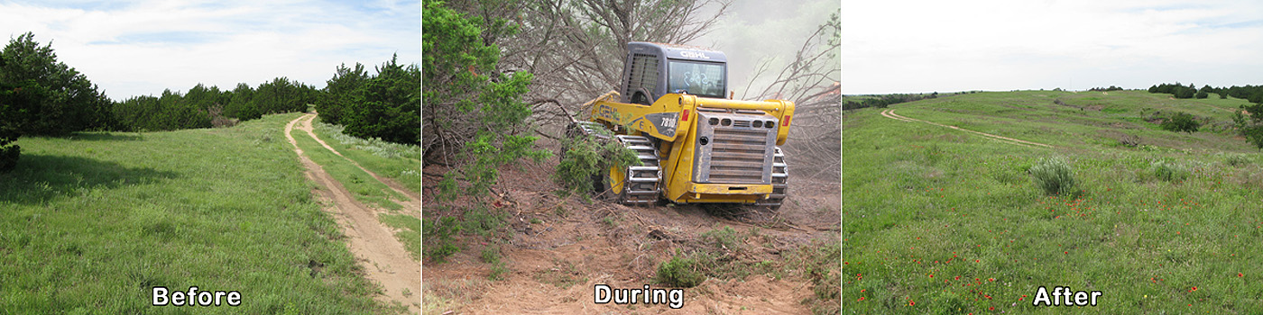
Mechanical Removal Control Option
Note areas where control occurred

Slide 9
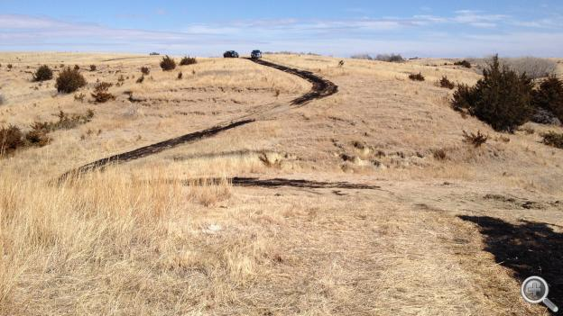
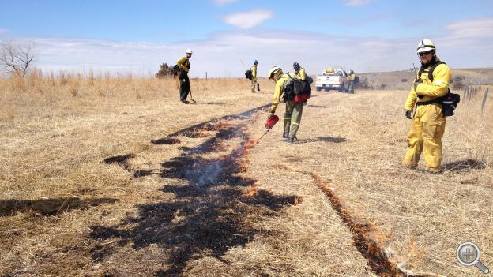
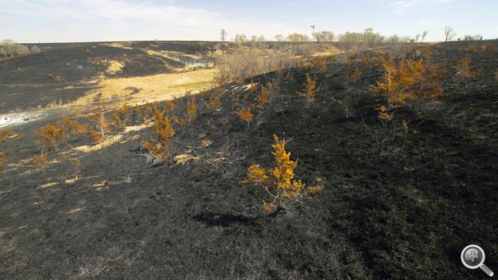
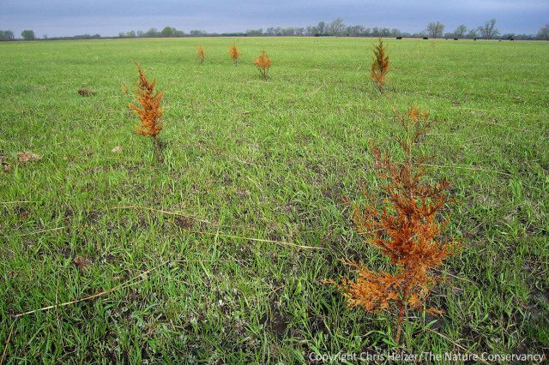
Prescribed Fire Management
2 Months after burn
http://netnebraska.org/article/news/911117/firefighters-make-fire-work-them-prescribed-burn http://prairieecologist.com/2013/03/12/should-we-be-conducting-prescribed-fires-during-drought/

Slide 10

Notes:
https://www.youtube.com/watch?v=GYJF-k8enz0

Slide 11
Day 2

Slide 12
Objectives
Define evolution
Define Natural Selection as a mechanism of evolution
Practice natural selection of invasive species
Define co-evolution

Slide 13
Define Evolution
E. redcedar trees did not evolve they invaded non-native areas because controls that kept them in check were removed (fire & grazing)
Evolution
  Gradual change of species over time
  All life on Earth shares a common ancestor
  Environment and evolution of common ancestor gave rise to diversity

Slide 14
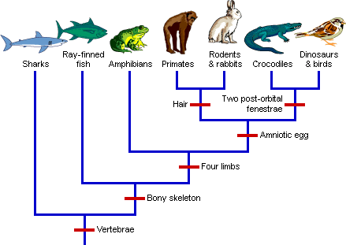
Define Evolution
Phylogeny
  Studying relationships between species
    Cladograms
    Family Trees
  Speciation occurs when lineage splits
    Speciation is the formation of new and distinct species
http://evolution.berkeley.edu/evolibrary/images/evo/patterns_intro.gif

Slide 15
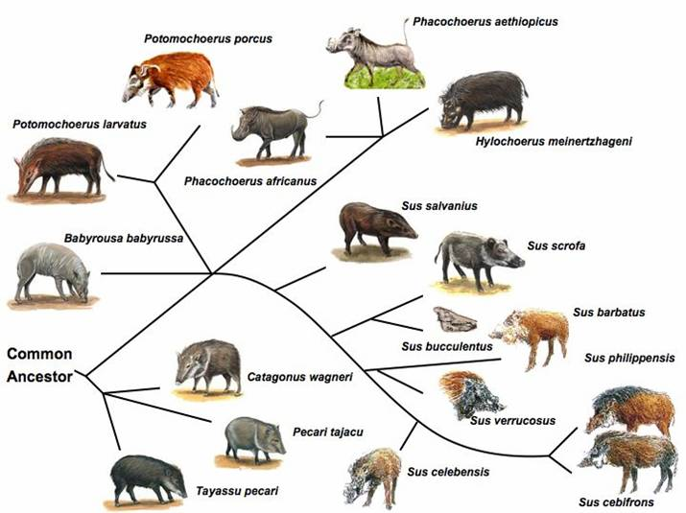
Define Evolution
Pig Species Family Tree
All derived from common ancestor
  Sus scrofa is the species for both domesticated and feral
Modern Day Fral Hog Species
http://www.untamedscience.com/family/suidae/

Slide 16
Objectives
Define evolution
Define Natural Selection as a mechanism of evolution
Practice natural selection of invasive species

Slide 17
Define Natural Selection as a mechanism of evolution
(1) Population of a species is able to reproduce
(2) Population of species has variation
  Mutation - change in the DNA
  Recombination of genes - new gene combinations because of meiosis and sexual reproduction
(3) Competition and predation act on the species population
(4) Environmental selection of the population’s offspring that are better able to survive will have better chance reproducing - survival of the fitness, only the strong survive

Slide 18
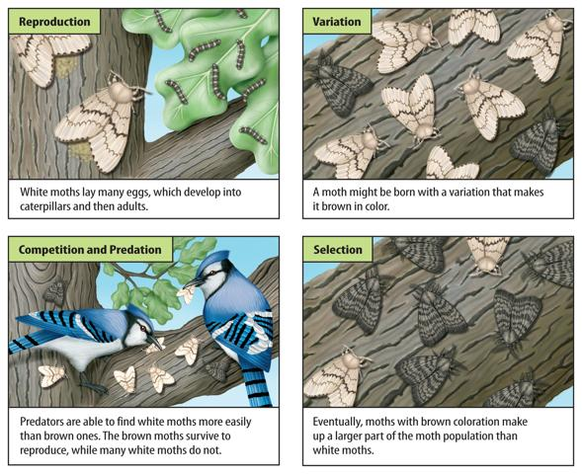
Define Natural Selection as a mechanism of evolution
http://marshscience7.blogspot.com/2013/12/natural-selection-adaptations.html

Slide 19
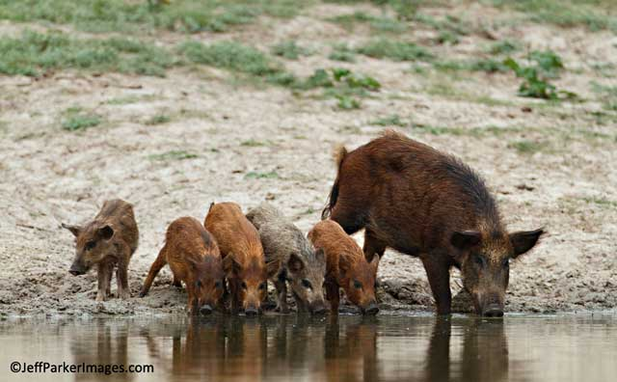
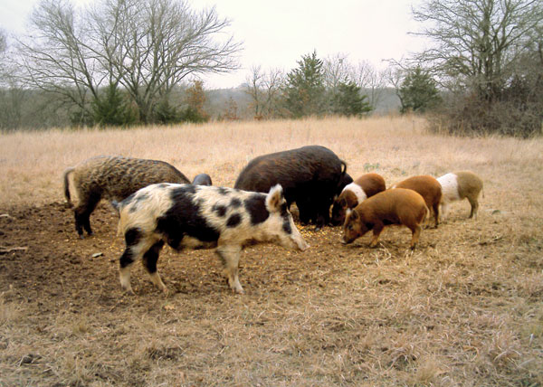
Feral Hog Example
Read Handout 2 to class for this slide
http://www.noble.org/ag/wildlife/feralhogs/characteristics/
http://www.apogeephoto.com/may2013/best-ways-to-photograph-javelinas.shtml

Slide 20
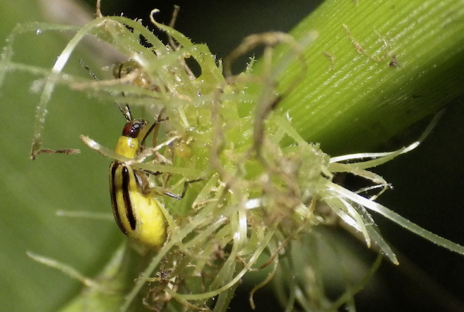
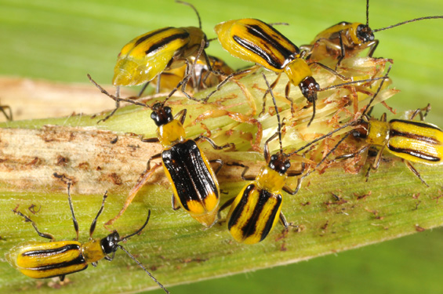
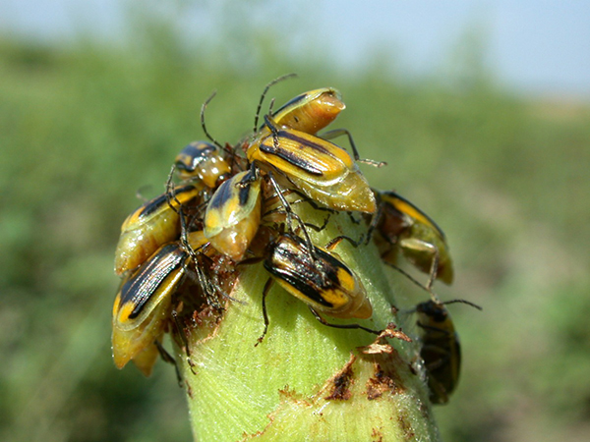
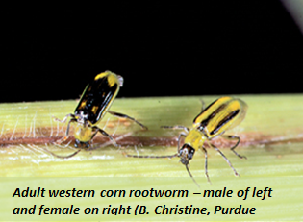
How does Rootworm Resistance relate?
http://ingienous.com/the-challenge/our-food-system/what-we-eat/why-monsanto-and-genetically-modified-food-is-bad-for-the-planet/
http://extension.entm.purdue.edu/radicalbugs/default.php?page=pests/western_corn_rootworm
http://images.publicradio.org/content/2011/08/16/20110816_rootworm-beetles_33.jpg
http://www.walknd.com/cpr/entomology/adult-corn-rootworms-emerging-08-01-13

Slide 21
Day 3

Slide 22
Objectives
Define evolution
Define Natural Selection as a mechanism of evolution
Practice natural selection of invasive species

Slide 23
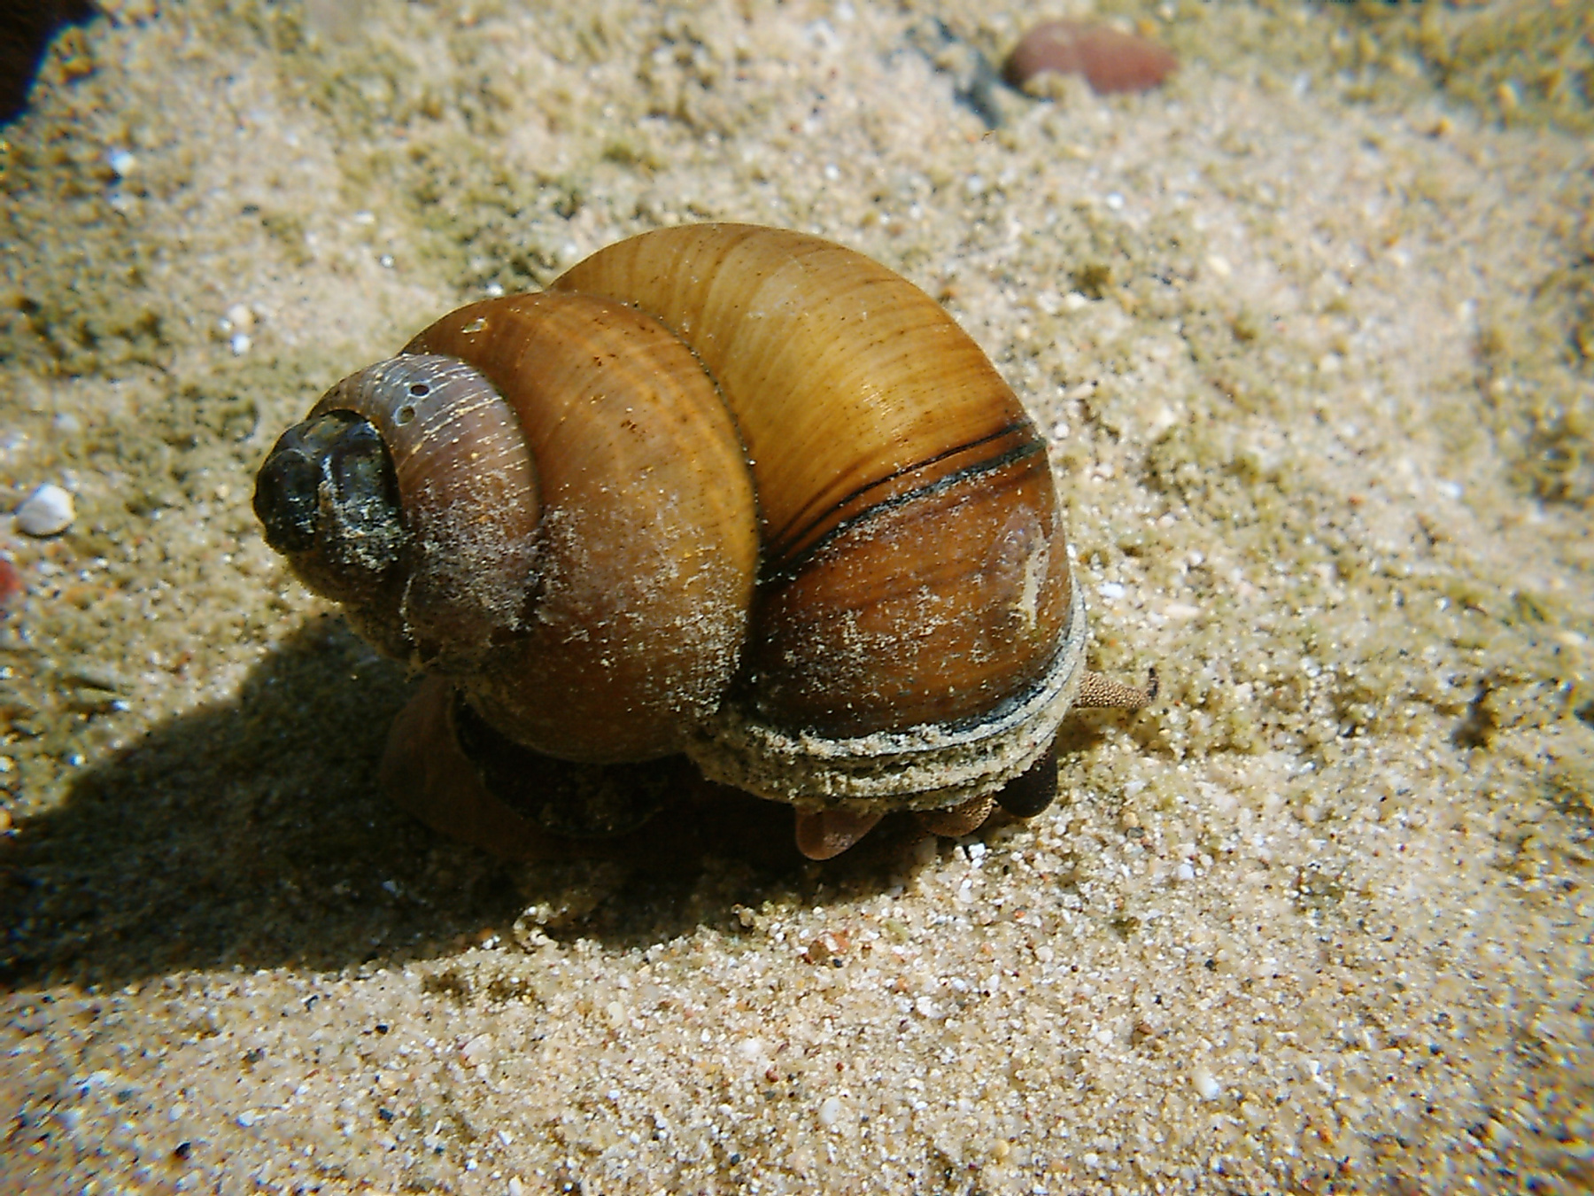
Chinese Mystery Snails
Large snails introduced through aquarium and Asian food trade
They can carry parasites and diseases
affecting native species
Their shells can clog screens and water intake pipes
They are very hardy able to survive winter and summer conditions
http://www.friendsofcrystallakewis.org/snails.html

Slide 24
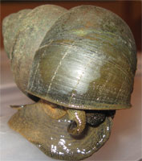
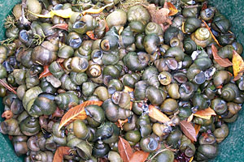
Practice natural selection of invasive species
Whose birthday is closest to October 31st?
  You win a trip to the hallway for the next 5 minutes
  Everyone else wins an invasive species
http://www.dfw.state.or.us/conservationstrategy/invasive_species/mystery_snail.asp

Slide 25
Walk student to the hallway
Give them the predator handout for them to draw an organism
Make sure they have a pen to draw with
Tell them you will get them in 5 mins

Slide 26
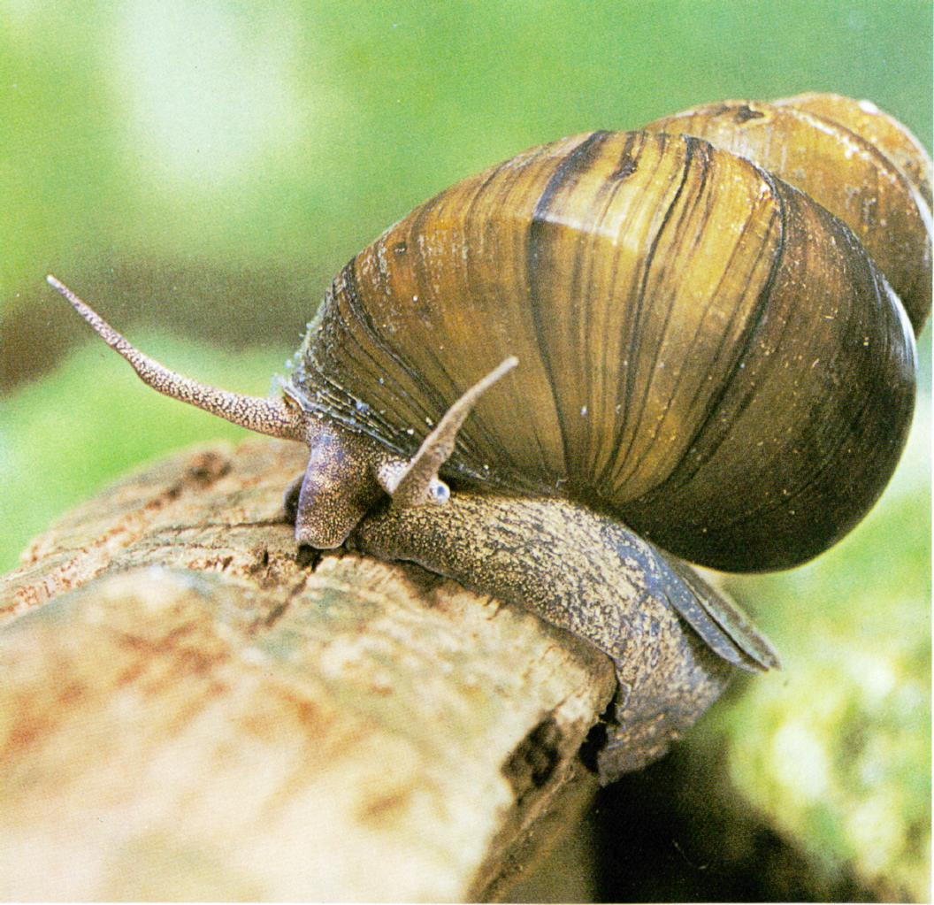
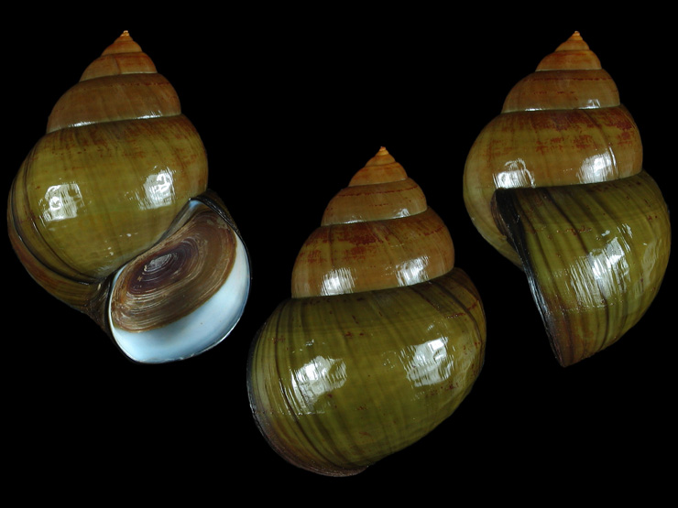
Practice natural selection of invasive species
Give each student an offspring worksheet
Your job is to draw an offspring derived from the Chinese Mystery Snail
Draw and color the offspring
Tape handout somewhere in the classroom
Set 5 minute timer
Sources: http://www.extendonondaga.org/natural-resources/invasive-species/aquatic-animals/chinese-mystery-snail/
https://www.google.com/search?q=mystery+snail+shell&espv=2&source=lnms&tbm=isch&sa=X&ved=0ahUKEwjd6aq45J_TAhUriFQKHTStAgcQ_AUIBygC&biw=1920&bih=1080#tbm=isch&q=chinese+mystery+snail+shell&imgrc=fcSzINQHOPojGM:

Slide 27
Release the Predator
Go to student in the hallway
Take their drawing from them
Tell them to enter the room & they have 1 min. to grab all student handouts they can
Tell them to stop at end of 1 minute
Tape the picture of their predator to the board

Slide 28

Activity Discussion
Activity was based on the Chinese Mystery Snail which can have up to 100 viable young for each brood and usually live up to 5 years.
Mystery Snails can vary in their color.
The snails that survived are the ones that are able to reproduce their traits to have more offspring.
Blending into the environment can increase survival

Slide 29
Practice natural selection of invasive species
(1) Reproduction -
  Students did by coloring and hanging drawings around room
(2) Variation
  Recombination of genes and Mutations lead to new colorings
(3) Competition and Predation
  Release of the Hallway Predator eats all snails it can in 1 minute around the room!!!!!!
(4) Survival of the fittest
  Organisms left can reproduce their traits to have more offspring
  Predator’s traits give them ability to eat many snails

Slide 30
  Break class into small groups 10 minutes to discuss
  Answer the following questions:
  How could more snail of survived?
    What happens if a different mutation occurred on one of the snails that lived?
    What happens if two of the snails got caught and put into an aquarium because they are pretty?
    What happens if there are no predators?
    What happens if thousands of snails die in an irrigation canal?

