Slide 1
Adaptations of Invasive Species
Curriculum PowerPoint

Slide 2
Video of 5 Extremely Invasive Species

Slide 3
What is the reason Asian carp were introduced into the United States?
Clear algae from ponds
2. What trait protects cane toads from predators?
Secretion of poison from glands in their shoulders
3. What could be done to stop introductions of invasive species?
Do not release non-native organisms, conduct thorough research before employing a biological control

Slide 4
Objectives
Define adaptations
Define three types of adaptations
Research invasive species adaptations
Introduce an organism to control an invasive species

Slide 5
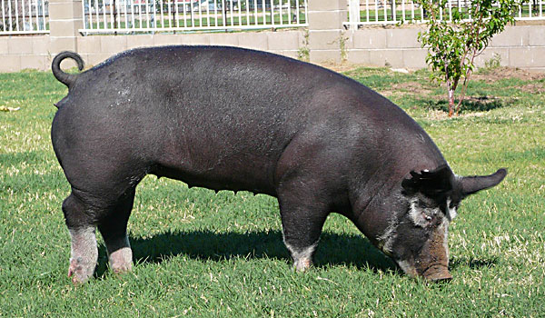
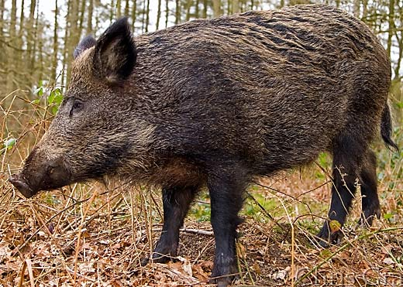
Define adaptations
Trait - feature of an organism
Genetic term review
Phenotype - Physical characteristics
Domestic hog on top has non-coarse body hair
Feral hog below has coarse body hair
http://arizonapork.com/images/2007/july/Yohn's-Berk-III.jpg
Feral hogs have course hair protecting them from the elements

Slide 6
Define adaptations
Adaptation - genetic change which a species becomes better suited to its environment.
Traits that increases survival
Traits that increases reproductive success

Slide 8
Define adaptations
Check for an understanding.
What genetics does Lebron James have?
Physically
Mentally
This gets tricky…..
https://strideline.wordpress.com/2015/02/12/lebron-james-and-cavs-have-dunk-party-vs-miami-video/

Slide 9
Define adaptations
Adaptation vs Acclimation
Adaptation
Genetic change increases survival
LBJ’s - height
Acclimation
Changes that increase function of an individual that are not genetic
LBJ’s - exercise
https://strideline.wordpress.com/2015/02/12/lebron-james-and-cavs-have-dunk-party-vs-miami-video/

Slide 10
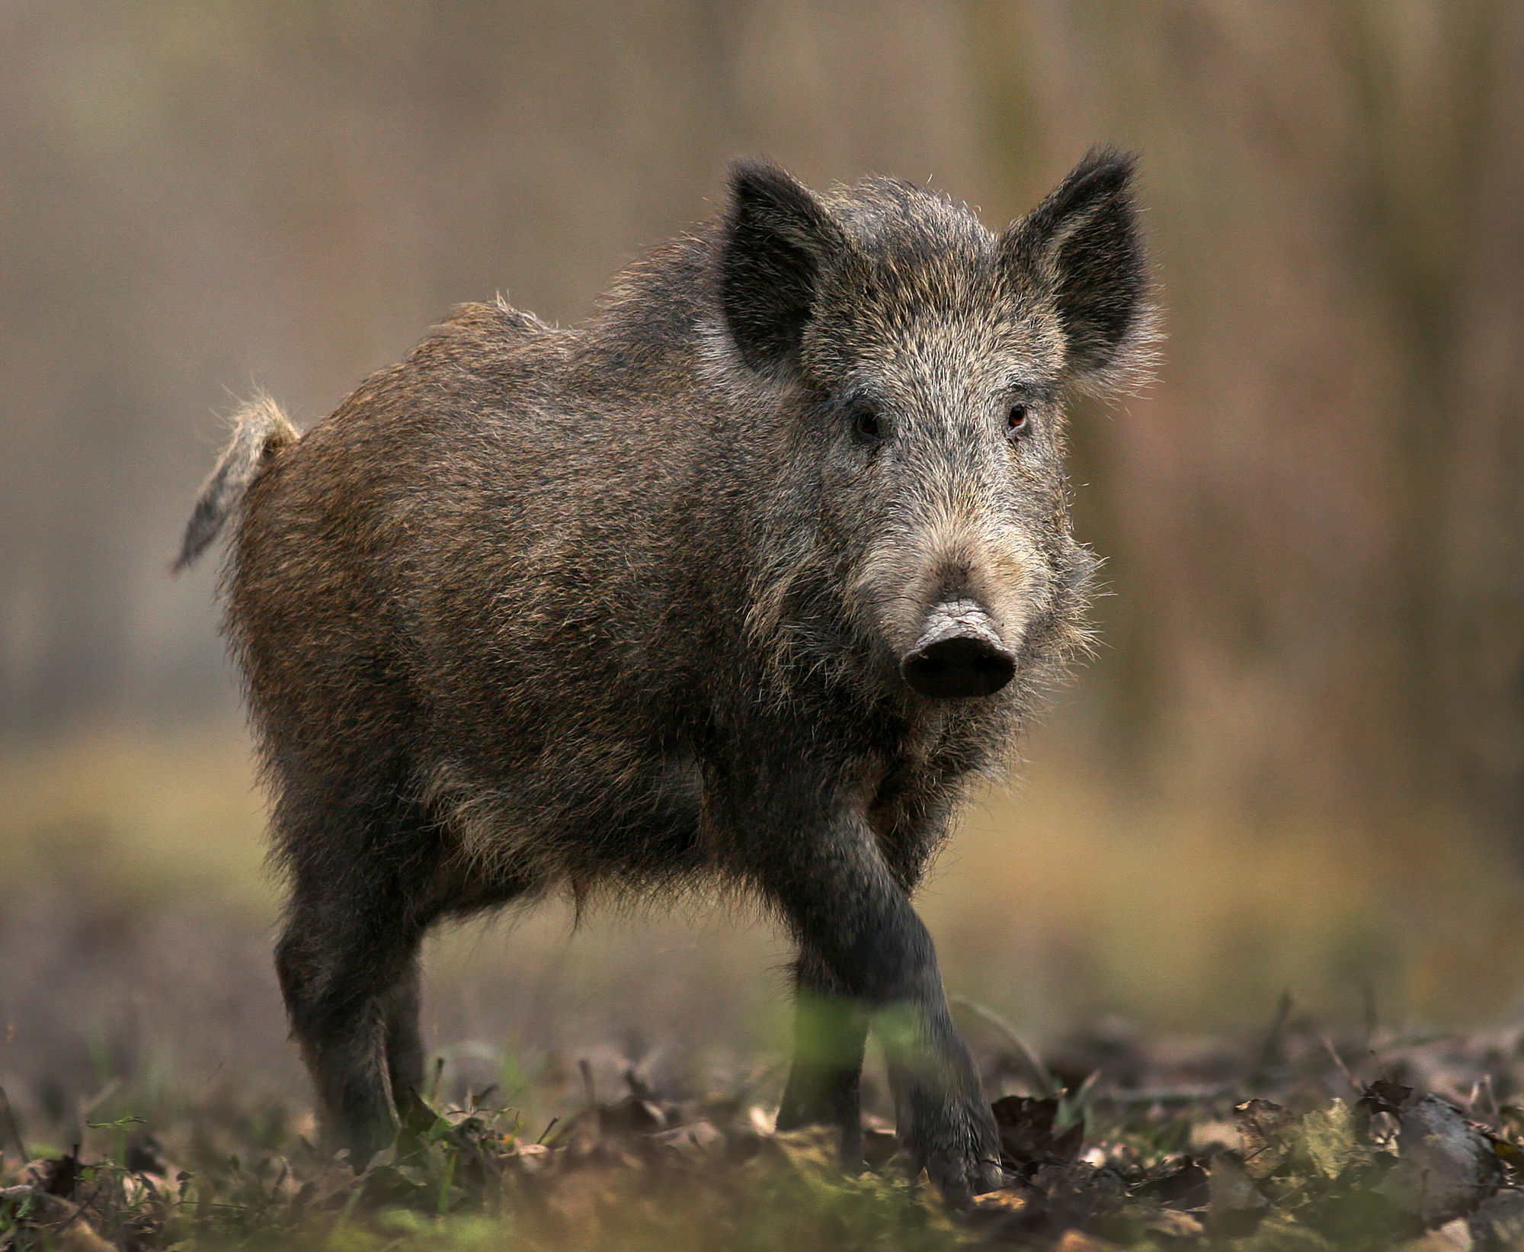
Name the following for this Feral Hog:
Trait
Adaptation
Acclimation

Slide 11
Objectives
Define adaptations
Define three types of adaptations
Research invasive species adaptations
Introduce an organism to control an invasive species

Slide 12
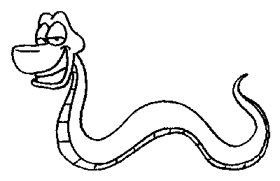
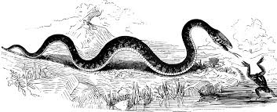
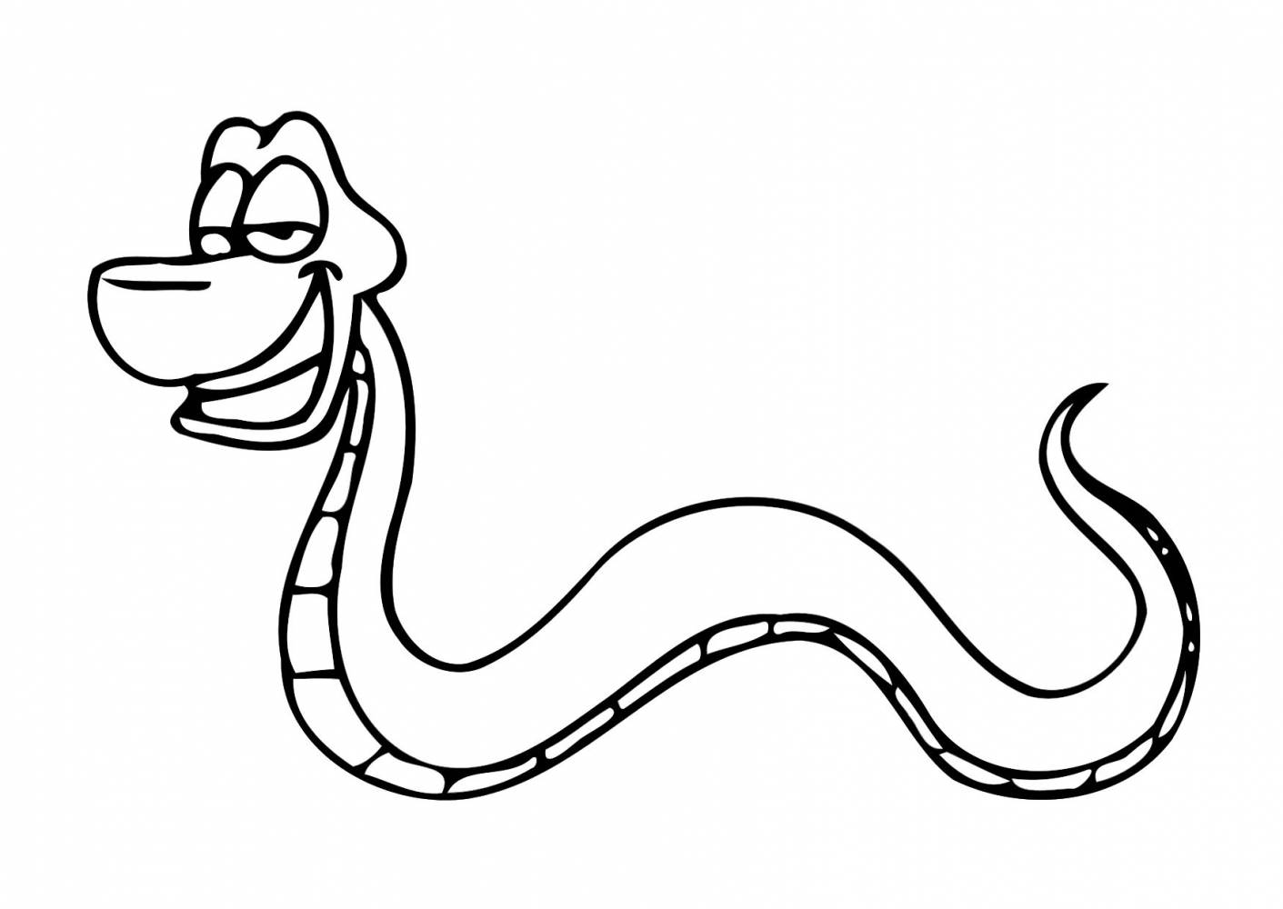
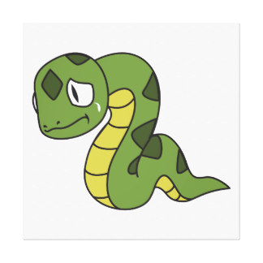
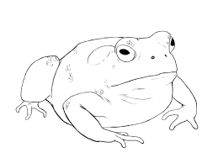
Define three types of adaptations
Behavioral Adaptations - related to the way something acts
Divide students into groups with 4 students in each
Give each group a student activity handout (next slide)
Each group reads the abstract found on this site: www.ncbi.nlm.nih.gov/pubmed/16777750
Each group draws a comic in 4 boxes on their paper showing the behavioral adaption of black snakes described in the abstract
Have each group present their cartoon to the class

Slide 13
Day 2

Slide 15
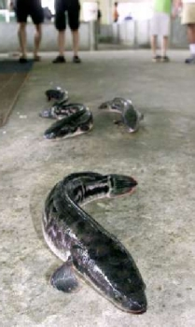
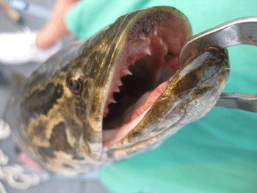
Review Snakehead Adaptations
Behavioral adaptations:
Aggressive
Morphological adaptations:
Muscular bodies
Sharp teeth
Physiological adaptations:
Can breath air
Can live out of water for several days if they stay moist.

Slide 17
Define three types of adaptations
Morphological Adaptations - the form or structure of an organism
Emerald Ash Borer
Flys
Jaws
Green

Slide 18
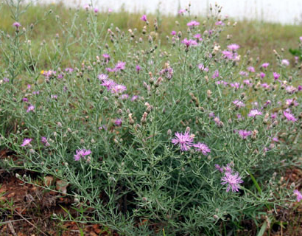
Define three types of adaptations
Physiological Adaptations - related to the way an organism functions
Allelopathy-An organism produces one or more
biochemicals that influence the growth,
survival, and reproduction of other
organisms
Spotted knapweed-secrets phytotoxic chemicals into
the soil which inhibit the growth of other plants.
http://extension.missouri.edu/webster/spotted-knapweed.aspx

Slide 19
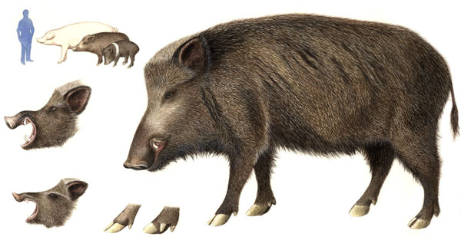
Define three types of adaptations
Review time
Your task is to match the following adaptations
that feral hogs have to
the three types of adaptations
http://www.konaearth.com/Life/2005/050702/

Slide 20
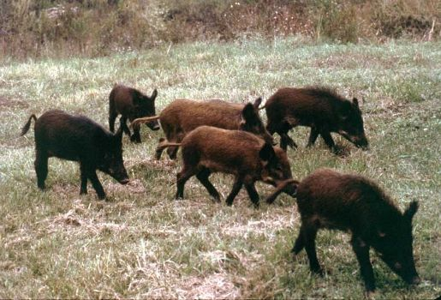
Define three types of adaptations
Morphological: Use senses to find food and shelter & evade predators.
Behavioral: They are omnivorous to increase the foods for their diet in the wild.
Physiological: Domestic hogs develop into feral hogs within 1-3 generations breeding in the wild. Within 1 generation they grow coarse body hair.

Slide 21
Objectives
Define adaptations
Define three types of adaptations
Research invasive species adaptations
Introduce an organism to control an invasive species

Slide 22
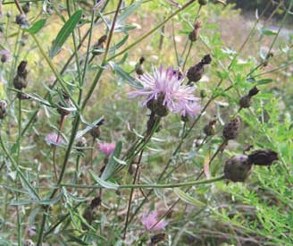
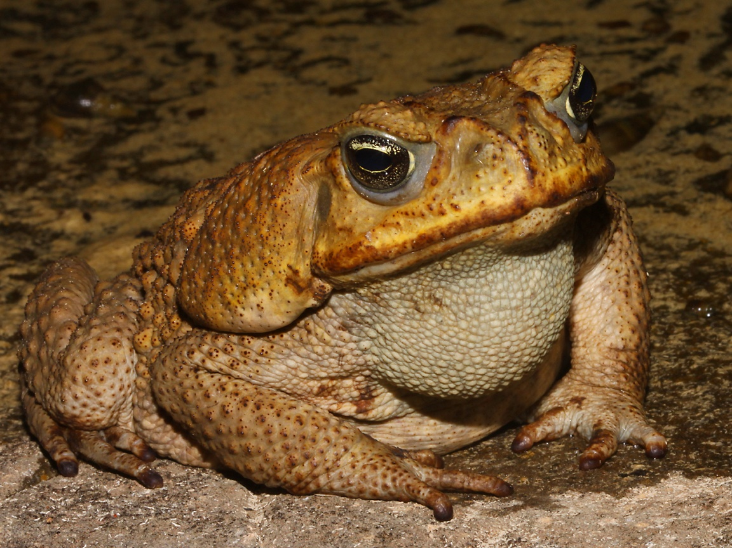
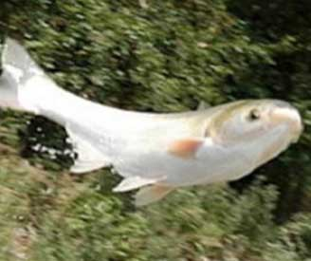
Research invasive species adaptations
Invasive Species - species that are non-native to the ecosystem under consideration and whose introduction causes harm to the economy, environment, or human health
Snakehead
Silver Carp
Feral Hogs
Spotted Knapweed
Cane Toad
http://www.richard-seaman.com/Wallpaper/Nature/Amphibians/MarineToad09.jpg
http://neinvasives.com/

Slide 23
Research invasive species adaptations
Break class into groups with 3 students in each
Give each group one of the species handouts
Small Indian Mongoose
Asian Carp
Constrictors
Zebra Mussels
European Starlings
Students answer 3 questions:

Slide 24
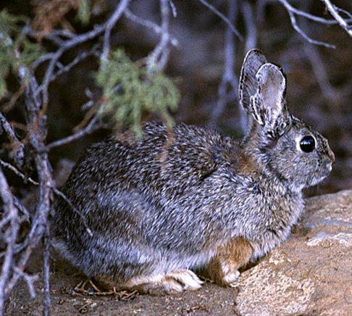
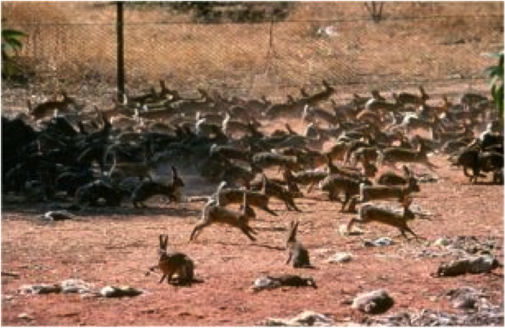
Example: European Rabbit
How as the species introduced: by a citizen. Originally from SW Europe & NW Africa.
What species or resources does it threaten: carries disease & depletes vegetation resources for other species.
Name 2 adaptations of this species to outcompete others: Rapid reproduction & growth

Slide 25
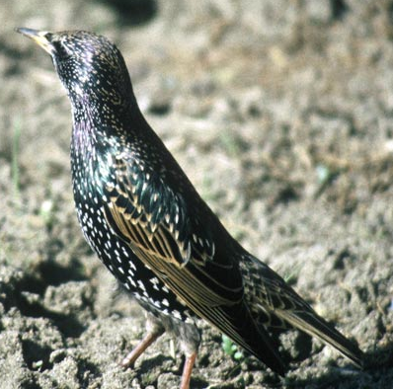
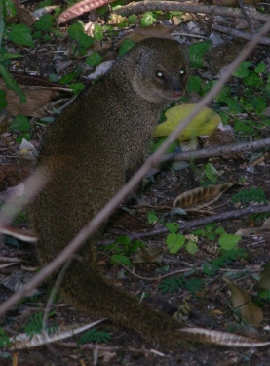
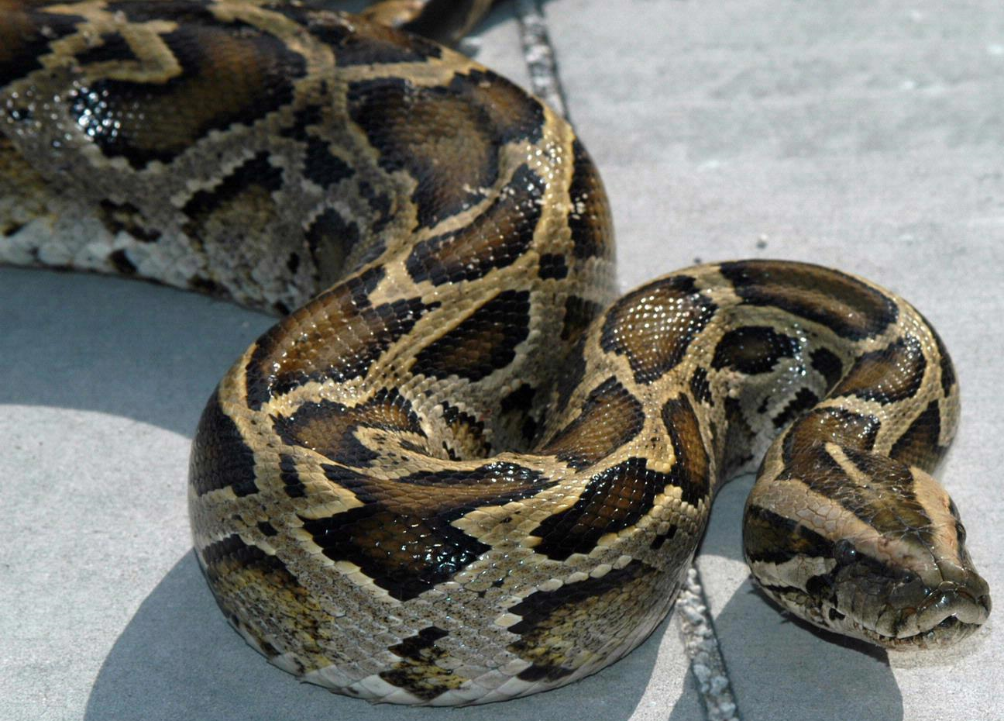
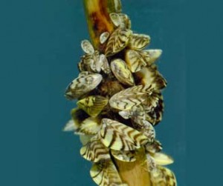
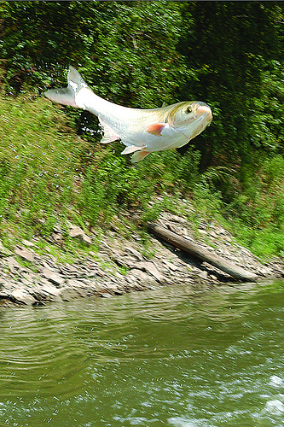
Starlings
Small Indian Mongoose
Burmese Python
Zebra Mussels
Asian Carp
Assign groups

Slide 26
Answer these questions in your group
* Write the Name of your species & team members on the top of the paper
1. How as the species introduced?
2. What species or resources does it threaten?
3. Name 2 adaptations of this species to outcompete others?

Slide 27
Groups Present Answers to Class
1. How as the species introduced?
2. What species or resources does it threaten?
3. Name 2 adaptations of this species to outcompete others?

Slide 28
Day 3

Slide 29
Objectives
Define adaptations
Define three types of adaptations
Research invasive species adaptations
Introduce an organism to control an invasive species

Slide 30
Biological Control of Invasive Species
Purple loosestrife is an invasive wetland plant that came from Eurasia
Galarucella beetle is a biological control
Eats and kills purple loosestrife only

Slide 32
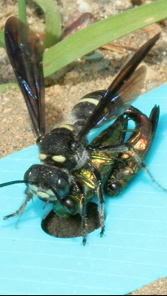
Biological controls of an invasive species
Biological control is a method of controlling pests (including insects, wildlife, aquatics, plants and diseases) using other living organisms.
Wasp keeps Emerald Ash Borer in check in native land
Being released in Michigan to see if it is a viable control
Native ground wasp, Cerceris fumipennis, as a biocontrol of Emerald Ash Borer
http://entomologytoday.org/2015/04/20/predatory-wasps-and-citizen-scientists-are-taking-on-the-emerald-ash-borer/

Slide 33
Activity
Invent a biological control for your invasive species
This is a made up species that doesn’t exist-feel free to pull ideas from existing species though.
Can be an insect, plant, disease, or wildlife species
Go through example of European Rabbit with students (next slide)
Split class into 5 group
Give each group a blank piece of paper & a species card

Slide 34
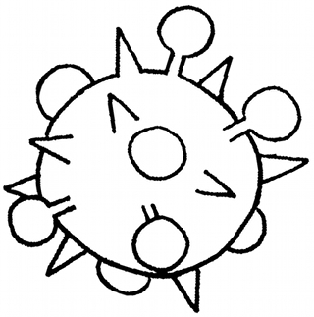
Example
Answer the 3 Questions:
How the biological control works to target the invasive species: It causes death in European rabbits by affecting their nervous systems. Mothers pass the disease to young.
Adaptation(s) the biological control species has to control invasive species: The virus can live in the soil for long periods of time which can infect more of the invasive rabbits reducing the population.
Describe how the biological control will be kept from becoming invasive: It is a naturally occurring disease. It only affects rabbit species. The virus will only be introduced into areas with high infestations of rabbits. It will quickly kill rabbits leaving the land devoid of them.
Draw picture of biological control you invented
European Rabbit Virus

Slide 35
Answer these 3 questions in your group
How the biological control works to target the invasive species
Adaptation(s) the biological control species
has to control invasive species
3. Describe how the biological control will be kept from becoming invasive

Slide 36
Groups Present Answers to Class
1. How the biological control works to target the invasive species
2. Adaptation(s) the biological control species
has to control invasive species
3. Describe how the biological control will be kept from becoming invasive

Slide 38
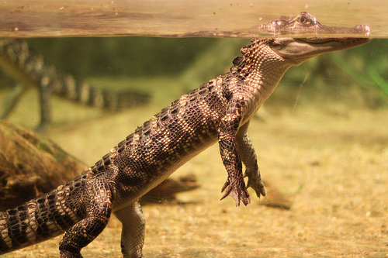
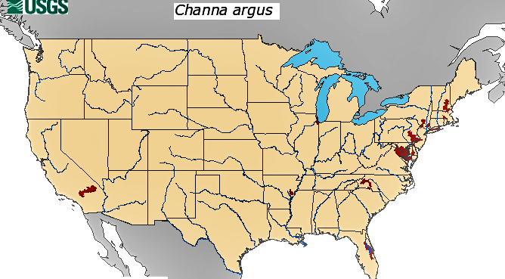
Eradication Is Not Always Possible
Snakeheads In China-kept in check by Alligators, larger fish and snakes
In the US-snakeheads are mainly in the eastern US where these predators do not exist
Introducing alligators and snakes which eat the fish in the native range isn’t feasible
Control options include managing the species through fishing and deterrents to contain the spread - not eradicating it
2015 Range of Snakehead in Red

Slide 39
Day 4

Slide 40
Objectives
Define adaptations
Define three types of adaptations
Research invasive species adaptations
Introduce an organism to control an invasive species

Slide 41
It’s (Not) Just A Bug Activity
Reflects on the challenges that farmers have in cultivating crops caused by invasive species
Access lesson: http://learning.blogs.nytimes.com/2007/06/19/its-not-just-a-bug/?_r=0

